Slide 1
IMC of ITI, Hathbandh
INDUSTRIAL TRAINING INSTITUTE, HATHBANDH
DISTRICT-RAIPUR, STATE- CHHATTISGARH
In
public private partnership
INDUSTRY PARTNER
GODAWARI POWER & ISPAT LIMITED
(HIRA GROUP of Industries)

Slide 2
IMC of ITI, Hathbandh
VISION
We at ITI Hathbandh, will impart futuristic Technical Education and instill high patterns of discipline through our dedicated staff who shall get global standards, making our students technologically superior and ethically strong who in turn shall improve the quality of life of the human race.

Slide 3
IMC of ITI, Hathbandh
Status of ITI Hathbandh before IMC
Building was not in good condition.
Shortage of faculty.
Shortage of tools & Equipments in Electrical, Fitter and COPA workshop.
Garden & Plantation was not there.

Slide 4
IMC of ITI, Hathbandh
Status of ITI Hathbandh before IMC
For welfare of Trainees:
Shortage of Sports Goods.
No Career Counseling Activity for Students.
No Health checkup.
No personality development classes for overall development of students.
No Suggestion and Feedback Box.

Slide 5
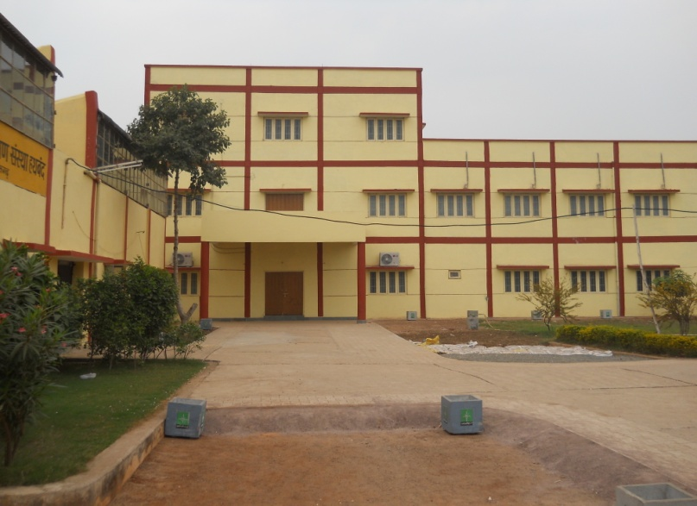
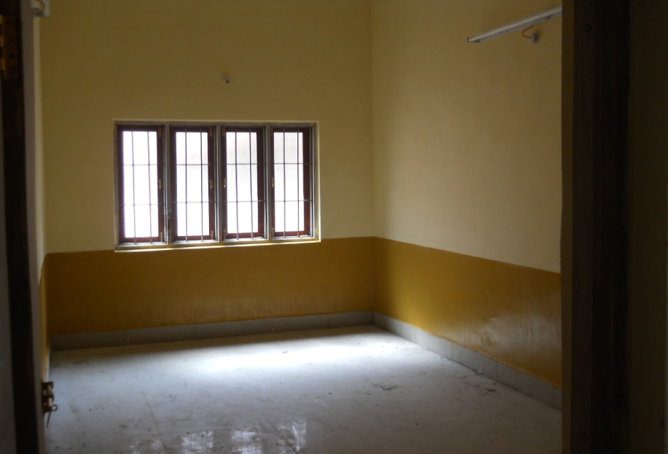
IMC of ITI, Hathbandh
Up gradation of Infrastructure
Construction of New I.T.I. Building (G+2) of
cost Rs. 1,04,66,350/- (One Crore Four Lacs
Sixty Six Thousand Three Hundred Fifty Only
completed.
As per IDP GODAWARI POWER & ISPAT LTD.
Contributed Rs. 55,00,000/- (Fifty Five Lacs
only) under civil head for construction of
new ITI building at ITI Hathbandh Campus.
3 New trades i.e. Wire drawing, Welder & Boiler
operator to be opened.
2 New batches of existing COPA & Electrical Trade
to be opened.

Slide 6
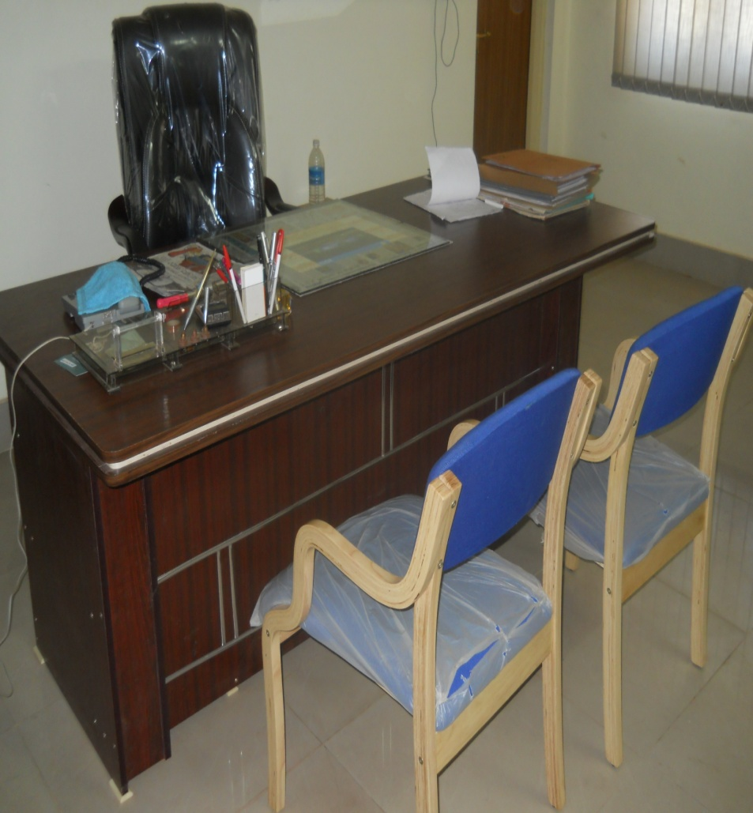
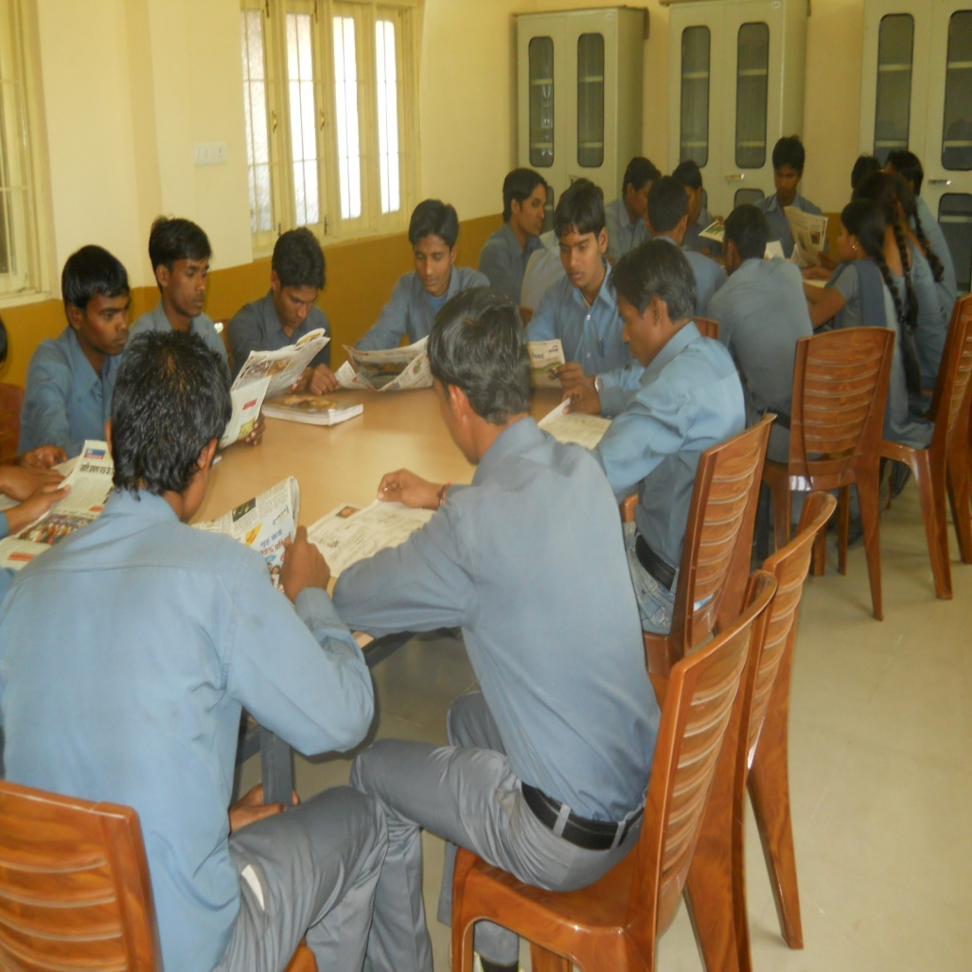
IMC of ITI, Hathbandh
Up gradation of Infrastructure
OFFICE & LIBRARY FURNITURE’S:

Slide 7
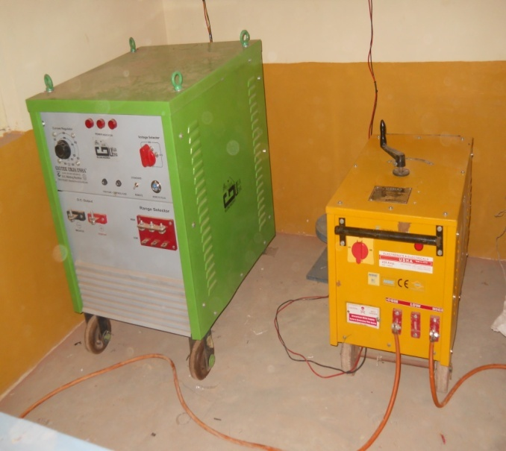
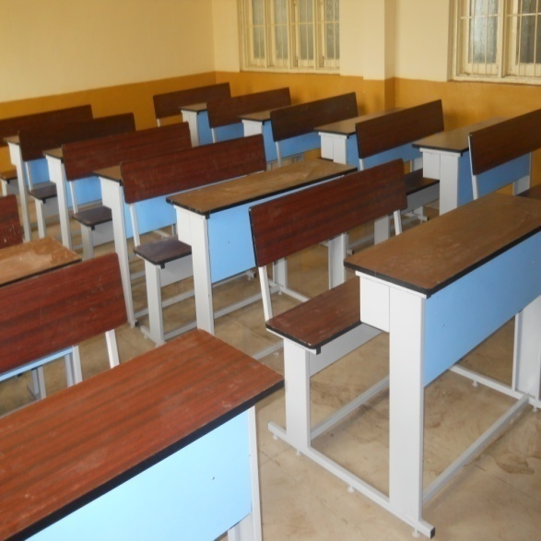
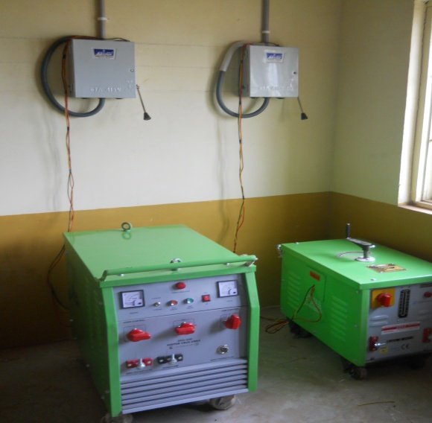
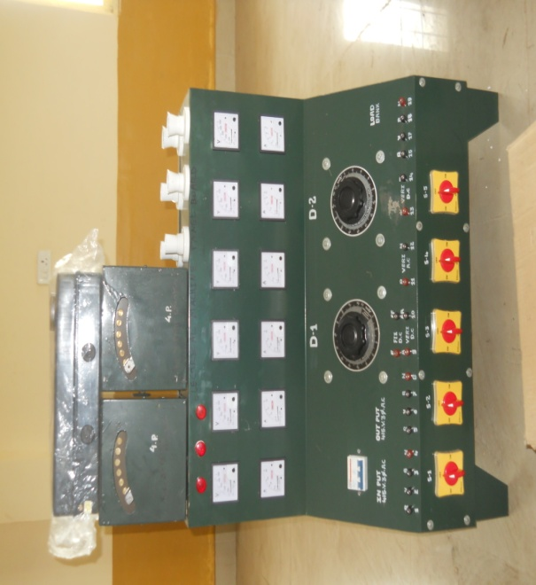
IMC of ITI, Hathbandh
Up gradation of Infrastructure
Tools & Equipments purchased for
new trades to be open.
i.e. Electrical & Welder
Dual-Desk for trainees

Slide 8
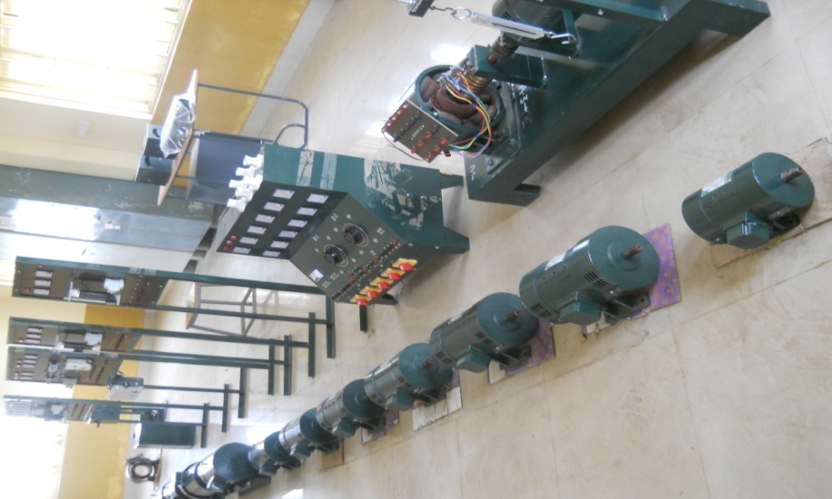
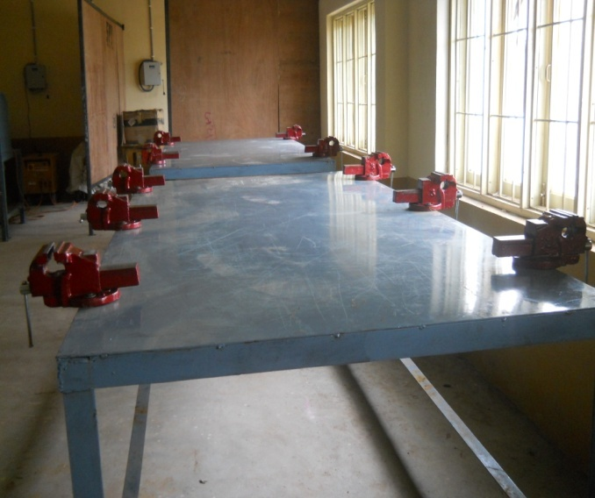
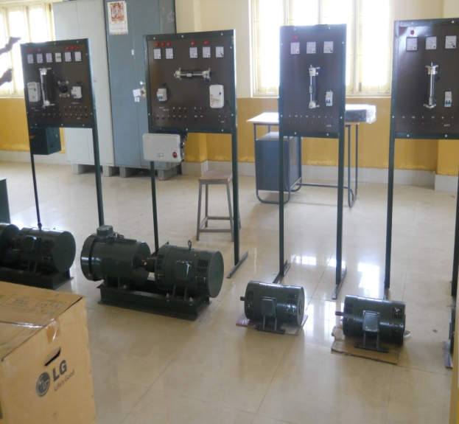
IMC of ITI, Hathbandh
Up gradation of Infrastructure
Tools & Equipments purchased
for new trades to be open.
i.e. Electrical & Welder

Slide 9
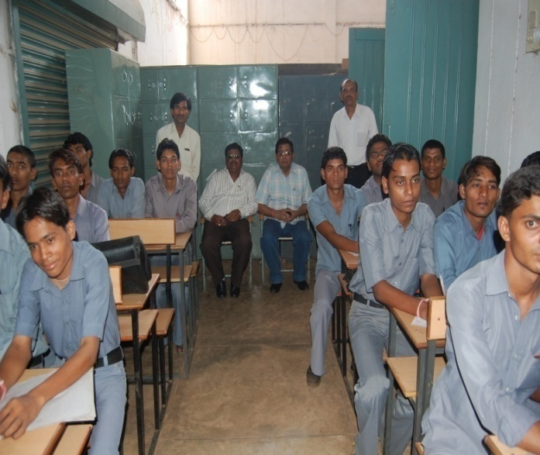
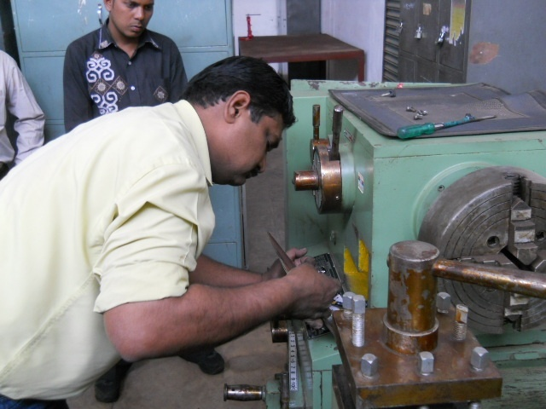
IMC of ITI, Hathbandh
Best Practices
IMC of ITI – HATHBANDH
Review and Motivational Talk For Trainess:
Repair and Maintenance of Machines
& provide special training by skilled
employee of Godawari Power & Ispat
Ltd.

Slide 10
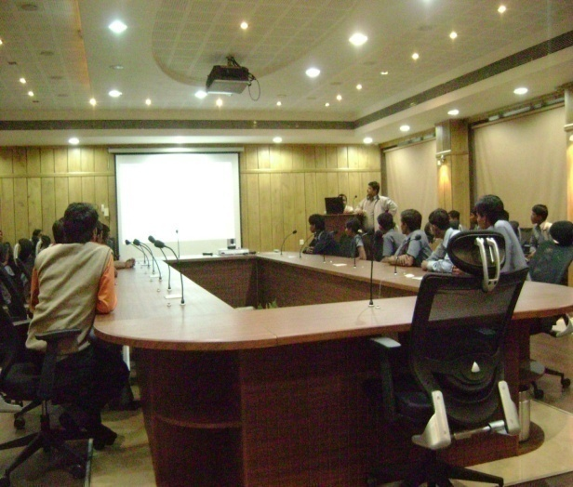
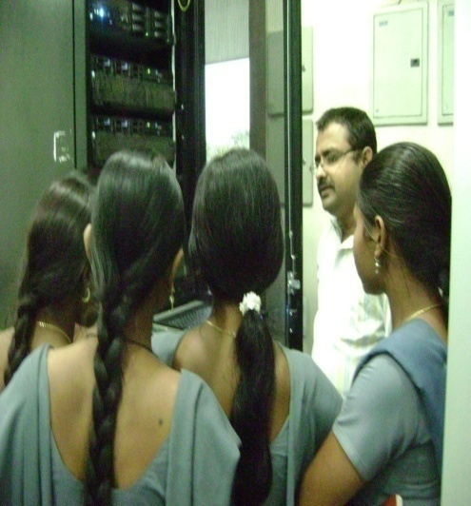
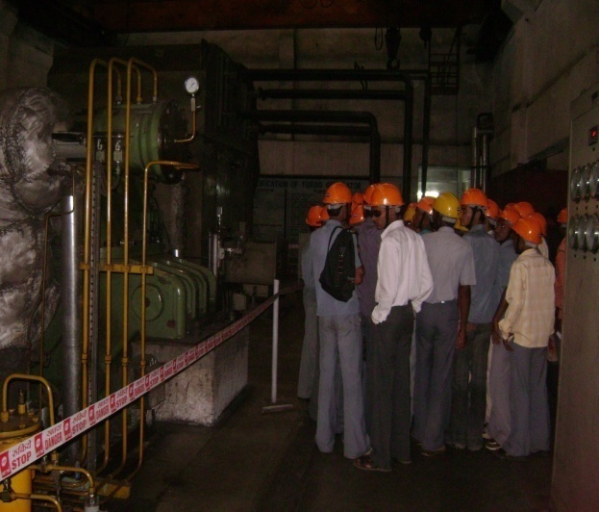
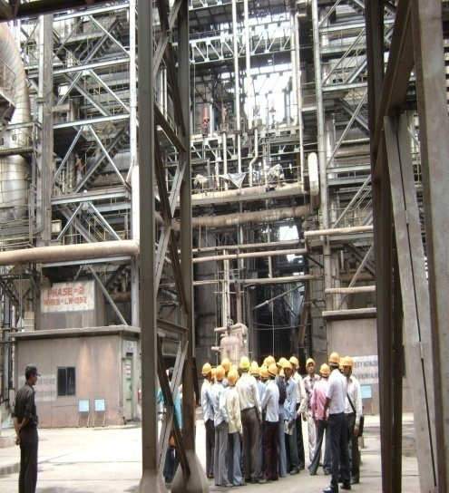
IMC of ITI, Hathbandh
Industrial Exposure
of IMC
Industrial visit of the
Trainees at Godawari
Power & Ispat Ltd. for
all the three trades and
SDI students.
On The Job Training of
Fitter and Electrical
Trade for 7 to 10 Days.

Slide 11
IMC of ITI, Hathbandh
Industrial Exposure
Trainees sent to
village:Nokh,
State: Rajasthan for
On the Job Training
in Solar power Plant of
Godawari Green Energy
Limited (Hira Group)
w.e.f. 10th Sept 2012
upto 10th December 2012.

Slide 12
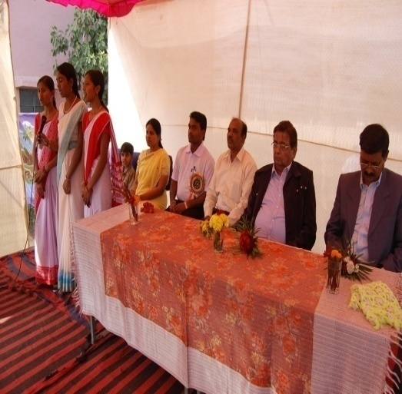
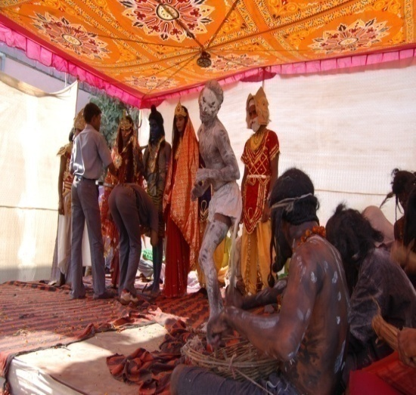
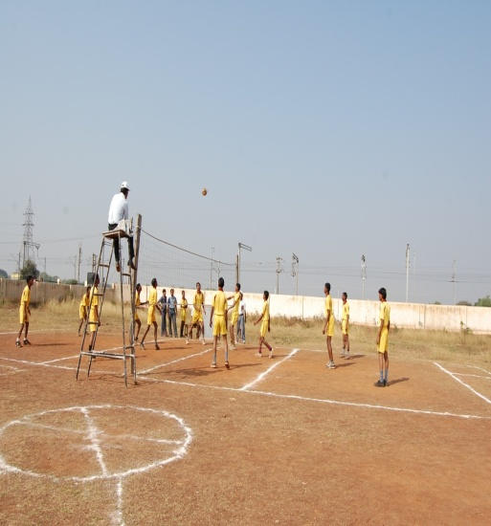
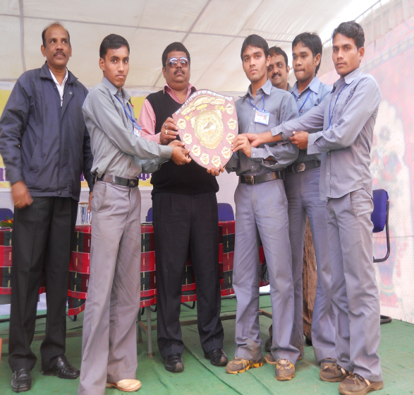
IMC of ITI, Hathbandh
Extra Curricular Activities
Annual Sports and
Cultural program for
successive Four years…

Slide 13
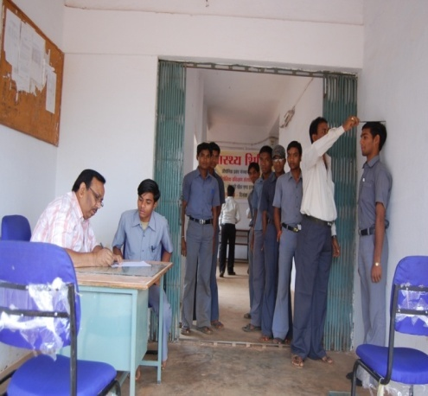
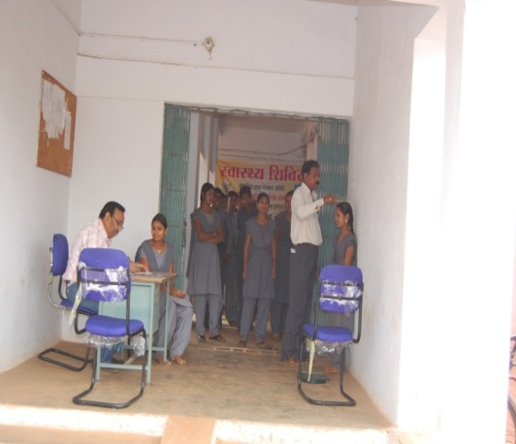
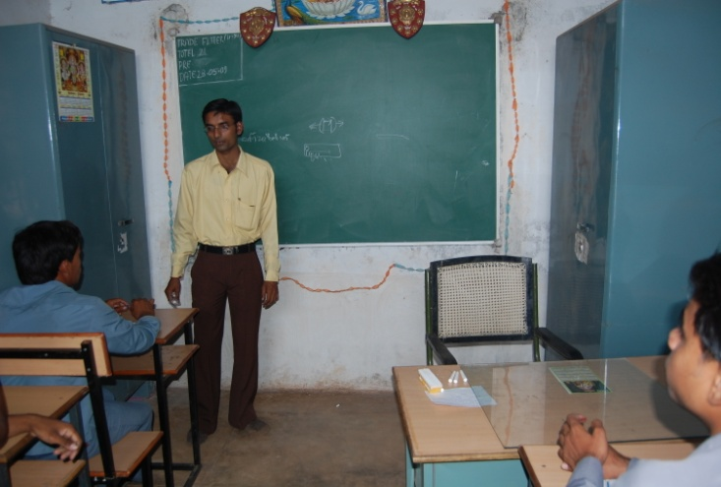
IMC of ITI, Hathbandh
Best Practices
IMC of ITI - HATHBANDH
Health Check-up for
Trainees.
Trained Faculty
Career Counseling
Workshops on Personality Development

Slide 14
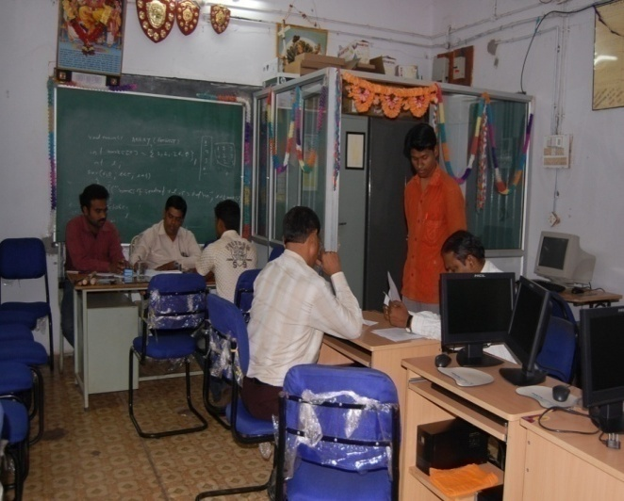
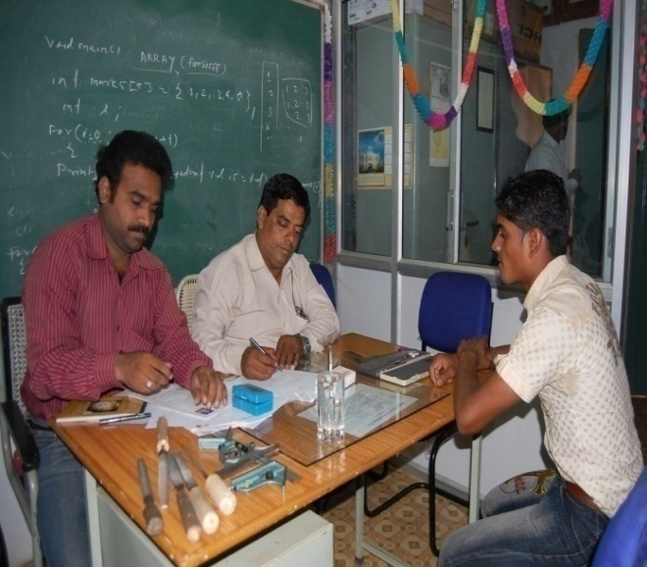
IMC of ITI, Hathbandh
Milestone Accomplished
Campus Placement
Campus Interview was conducted
by Godawari Power & Ispat Limited,
R.R. Ispat Ltd.,Hira Ferro Alloys Ltd.,
Jagdamba Power Plant (Hira Group
of Industries) for electrical and Fitter trade.
32 Electrical students placed in R.R. Ispat Ltd.
33 Fitter students placed in Godawari Power & Ispat Ltd.

Slide 15
IMC of ITI, Hathbandh
Short Term Courses
Skill Development Initiative (SDI Scheme) & SUDA
Registration of Courses with RDAT, Kanpur.
Basic Electrical
A.C. & D.C. Motor Winding
House Wiring
M.S.Office & Internet
Tally 9.0
5 Batches of SDI mes courses Completed Successfully.
Skill Urban Development Authority
Basic Electrical
M.S. Office & Internet
2 Batches of SUDA courses completed successfully.
Mukhya Mantri Kaushal Vikas Yogna.

Slide 16
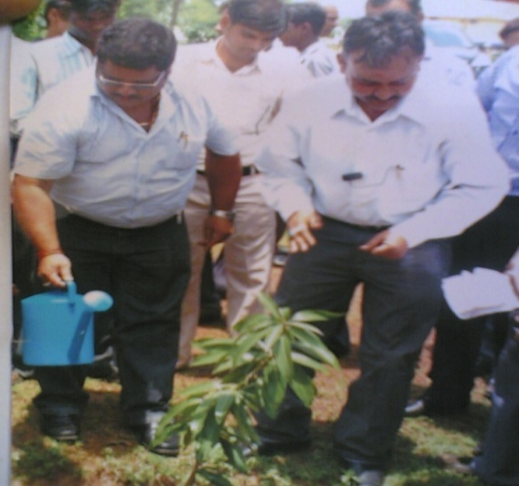
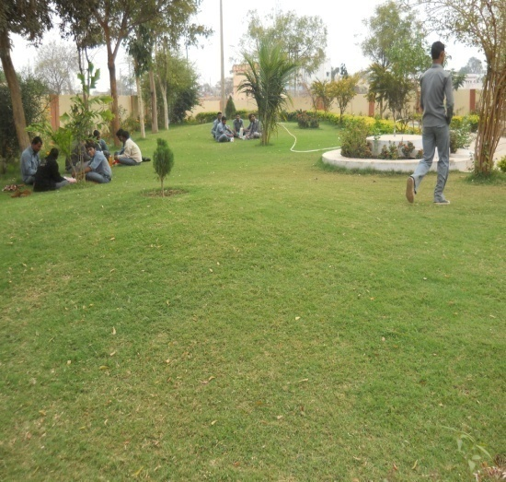
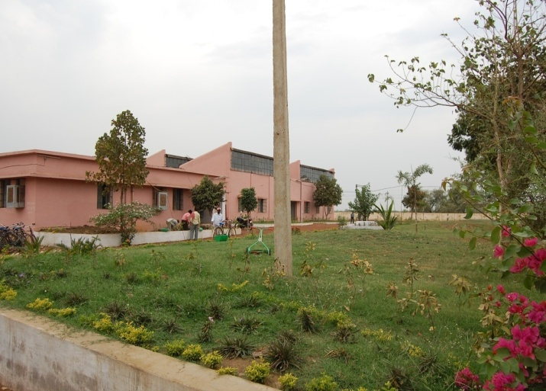
IMC of ITI, Hathbandh
Best Practices
IMC of ITI - HATHBANDH
For Environment:
Plants were planted by
Godawari Power & Ispat Ltd.
after Annual Sports Program.
Plants were planted
after Bhumi pujan
of new I.T.I.,building
Landscaping work was
done by Godawari Power
& Ispat Ltd.

Slide 17
IMC of ITI, Hathbandh
The Path Ahead!
Cycle Stand for students.
New Building of ITI completed, New trades to be open.
Strength of students to be increased to 500.
Target of 100% Employability.

Slide 18
IMC of ITI, Hathbandh
Under the leadership of Mr. Siddhartha Agrawal, Chairman IMC of ITI, Hathbandh, & Godawari Power Ispat Ltd. as an Industry Partner is following all the guidelines specified by DGET;
We are committed to make ITI Hathbandh; a model for other ITI’s to follow.

Slide 19
IMC of ITI, Hathbandh
THANK YOU

